Slide 1

C Language

Slide 2
Content
1. Generation of programing language,
2. Difference between high level and low level programming language
3.Purpose of compiler,What is C Language,Why C Language
4. C keywords, Operators, Datatypes, Scope of Variables, Sequencial program example

Slide 3
Generation of programing language
Programming languages have evolved significantly over the years, with each generation introducing new features, paradigms, and improvements. Here's an overview of the generations of programming languages:
1. First Generation (1940s-1950s):
- Machine Language: The earliest programming languages were machine-specific and closely tied to the computer's hardware.
- Binary Code: Programmers had to write instructions using binary code, which was extremely low-level and error-prone.
- No high-level abstractions: These languages had no abstractions or human-readable syntax, making programming challenging and time-consuming.

Slide 4
Generation of programing language
2. Second Generation (1950s-1960s):
- Assembly Language: Assembly languages introduced mnemonic codes that represented low-level operations, making programming slightly more human-readable.
- Still hardware-dependent: Assembly languages were tied to specific hardware architectures.
3. Third Generation (1960s-1970s):
- High-Level Languages: Third-generation languages like FORTRAN, COBOL, and ALGOL were developed.
- Abstraction: These languages provided higher-level abstractions, making it easier to write programs.
- Portability: Programs written in third-generation languages could be executed on different hardware with the help of compilers.

Slide 5
Generation of programing language
4. Fourth Generation (1980s-Present):
- Domain-Specific Languages (DSLs): Fourth-generation languages focus on specific application domains, such as SQL for databases or MATLAB for numerical computing.
- Emphasis on productivity: These languages are designed to increase developer productivity by offering high-level abstractions and specialized tools.
- Examples: SQL, MATLAB, R, and scripting languages like Python.
5. Fifth Generation (Late 1980s-Present):
- Logic Programming: Fifth-generation languages like Prolog are used for symbolic reasoning and artificial intelligence applications.
- Parallelism: Some fifth-generation languages support parallel and concurrent programming.
- Emphasis on declarative programming: Logic and constraint-based programming are central to these languages.

Slide 6
Generation of programing language
6. Sixth Generation (Speculative):
- Quantum Programming: As quantum computing advances, new programming languages are emerging to harness the power of quantum computers.
- Emphasis on quantum principles: Quantum programming languages like Q# and Cirq focus on quantum algorithms and quantum hardware.
7. Future Generations (Speculative):
- Quantum, Neuromorphic, and Biological Computing: Future generations may continue to evolve with emerging technologies, such as quantum computing, neuromorphic computing, and biological computing.
- Sustainability and Ethical Considerations: Future languages may also emphasize sustainable coding practices and ethical considerations.

Slide 7
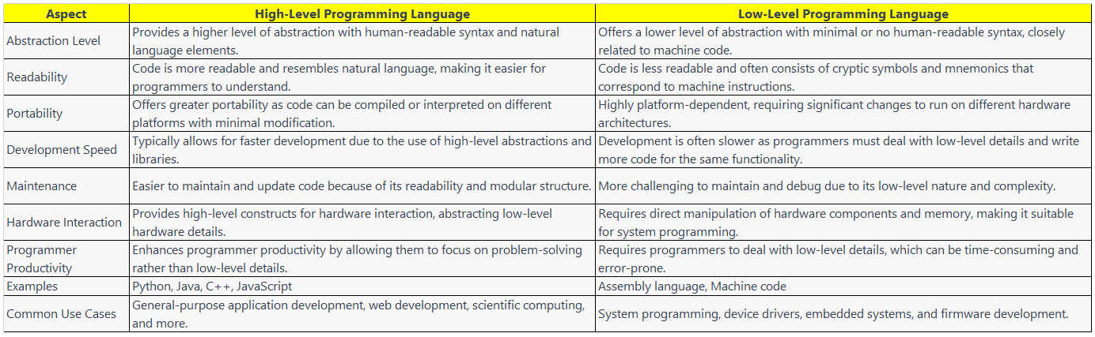
Difference between high level and low level programming language

Slide 8
Purpose of compiler
A compiler is a fundamental tool in computer science and programming, and its primary purpose is to translate high-level programming code written by developers into machine code or lower-level code that can be executed directly by a computer's central processing unit (CPU). Here are the key purposes and benefits of using a compiler:
1. **Translation**: The primary function of a compiler is to translate source code written in a high-level programming language (e.g., C++, Java, Python) into machine code or an intermediate representation (e.g., bytecode) that can be executed by the computer.
2. **Efficiency**: Compilers often perform optimization techniques to produce more efficient machine code. These optimizations can include code simplification, dead code elimination, and reordering of instructions to improve execution speed and reduce memory usage.

Slide 9
Purpose of compiler
3. **Portability**: Compilers allow developers to write code in a high-level language that can be executed on different hardware platforms without modification. This portability is achieved by producing machine-independent code or using a virtual machine (e.g., Java Virtual Machine) to run bytecode.
4. **Error Checking**: Compilers perform various checks on the source code, including syntax and type checking, to catch errors and issues before the program is executed. This helps in identifying and fixing bugs early in the development process.
5. **Security**: Compilers can contribute to code security by preventing certain types of vulnerabilities, such as buffer overflows, through their optimization and error-checking processes.

Slide 10
Purpose of compiler
6. **Code Organization**: Compilers help organize code into a format that is suitable for execution. They generate executable files or bytecode files that can be run by the operating system or virtual machine.
7. **Resource Management**: Compilers allocate and manage resources such as memory and registers efficiently, ensuring that programs use system resources effectively.
8. **Performance**: By translating high-level code into optimized machine code, compilers can significantly improve the performance of a program compared to interpreting the code directly. This is particularly important for resource-intensive applications.

Slide 11
Purpose of compiler
9. **Debugging**: Compilers often provide debugging information that can be used by integrated development environments (IDEs) and debugging tools to assist developers in identifying and fixing issues in their code.
10. **Code Obfuscation**: In some cases, compilers can be used to obfuscate code, making it more difficult for reverse engineers to understand or modify the program. This is often employed in commercial software to protect intellectual property.

Slide 12
What is C Language
C is a high-level programming language that was developed in the early 1970s by Dennis Ritchie at Bell Labs. It is one of the most influential and widely used programming languages in the history of computing. Here are some key characteristics and aspects of the C programming language:
1. **Procedural Language**: C is primarily a procedural programming language. It emphasizes the use of functions or procedures to organize and structure code. Programs written in C consist of functions that perform specific tasks.
2. **Middle-Level Language**: C is often described as a middle-level language because it combines elements of both high-level and low-level programming languages. It provides a high degree of control over hardware resources while offering higher-level abstractions than assembly language.

Slide 13
What is C Language
3. **Portable**: C programs can be written in a way that is highly portable, meaning they can be compiled and run on various hardware and operating system platforms with minimal or no modification.
4. **Efficiency**: C is known for its efficiency in terms of execution speed and memory usage. It allows low-level memory manipulation and direct access to hardware, making it suitable for systems programming and embedded systems.
5. **Standard Library**: C comes with a standard library (the C Standard Library) that provides a set of functions and headers for common tasks like input/output, string manipulation, and math operations. This library is available on most C compilers.

Slide 14
What is C Language
6. **Pointers**: C includes support for pointers, which are variables that store memory addresses. Pointers are a powerful feature for working with data structures and memory allocation but require careful management to prevent errors.
7. **Simple Syntax**: C has a relatively simple and concise syntax, which makes it easier to learn and write code. Its syntax serves as the foundation for many subsequent programming languages.
8. **Extensive Use**: C has been used in a wide range of applications, including operating systems (e.g., UNIX and Linux kernels), embedded systems (e.g., microcontrollers), game development, scientific computing, and more.

Slide 15
What is C Language
9. **Influential**: Many other programming languages, such as C++, C#, Objective-C, and even parts of Java, have been influenced by or directly derived from C.
10. **Standardization**: The C language has an ANSI C (also known as C89 or C90) standard and later versions like C99 and C11, which provide specifications for the language and its standard library functions.

Slide 16
Why C Language
The C programming language has remained popular and influential in the world of programming for several reasons:
1. **Portability**: C code can be compiled and run on various hardware and operating system platforms with minimal or no modification. This portability is a significant advantage, especially in systems programming, where the code needs to run on different types of hardware.
2. **Efficiency**: C is known for its efficiency in terms of execution speed and memory usage. It allows for low-level memory manipulation and direct access to hardware resources, making it suitable for applications where performance is critical.
3. **Low-Level Control**: C provides a high degree of control over hardware resources. It allows programmers to manipulate memory directly through pointers and work with specific hardware features when necessary.

Slide 17
Why C Language
4. **Large Standard Library**: C comes with a standard library (the C Standard Library) that provides a wide range of functions for common tasks like input/output, string manipulation, and mathematical operations. This library is available on most C compilers.
5. **Procedural Programming**: C is primarily a procedural programming language, which is an effective paradigm for structuring code and solving problems step by step. It is easy to learn and understand the procedural programming approach.
6. **Influential**: Many modern programming languages have been influenced by or directly derived from C. For example, C++ extends C with object-oriented features, while C# and Objective-C are also based on C syntax.

Slide 18
Why C Language
7. **Versatile**: C is a versatile language that can be used for a wide range of applications, including systems programming, embedded systems development, game development, scientific computing, and more.
8. **Community and Resources**: C has a large and active community of developers and a wealth of educational resources, books, tutorials, and libraries available to support learning and development in the language.
9. **Legacy Code**: Many legacy systems and critical software components are written in C. Understanding C allows programmers to maintain and extend these systems.
10. **Time-Tested**: C has a long history of successful use in various domains. It has been extensively tested and proven in real-world applications, making it a reliable choice for software development.

Slide 19
C keywords
C programming language has a set of reserved keywords that have specific meanings within the language and cannot be used as identifiers (such as variable or function names). Here is a list of some of the most commonly used C keywords:
1. **auto**: Declares a local variable with automatic storage duration.
2. **break**: Exits the innermost loop or switch statement.
3. **case**: Defines a specific value or condition in a switch statement.
4. **char**: Declares a character data type.
5. **const**: Declares a constant variable, whose value cannot be changed after initialization.
6. **continue**: Jumps to the next iteration of a loop.

Slide 20
C keywords
7. **default**: Defines the default case in a switch statement.
8. **do**: Starts a do-while loop.
9. **double**: Declares a double-precision floating-point data type.
10. **else**: Specifies the code block to be executed if a condition in an if statement is false.
11. **enum**: Defines an enumeration data type.
12. **extern**: Declares a variable as external, meaning it is defined elsewhere in the code.

Slide 21
C keywords
13. **float**: Declares a floating-point data type.
14. **for**: Starts a for loop.
15. **goto**: Transfers control to a labeled statement.
16. **if**: Conditionally executes a block of code.
17. **int**: Declares an integer data type.
18. **long**: Declares a long integer data type.
19. **register**: Suggests to the compiler that a variable should be stored in a CPU register for faster access.
20. **return**: Exits a function and optionally returns a value.

Slide 22
C keywords
21. **short**: Declares a short integer data type.
22. **signed**: Declares a signed data type (int, char, etc.).
23. **sizeof**: Returns the size, in bytes, of a data type or expression.
24. **static**: Declares a static variable, which retains its value between function calls.
25. **struct**: Defines a structure data type.
26. **switch**: Starts a switch statement.

Slide 23
C keywords
27. **typedef**: Defines a new data type using an existing one.
28. **union**: Defines a union data type.
29. **unsigned**: Declares an unsigned data type (e.g., unsigned int).
30. **void**: Indicates that a function does not return a value or that a pointer does not have a specific data type.
31. **volatile**: Specifies that a variable can be changed by external sources and should not be optimized by the compiler.
32. **while**: Starts a while loop.

Slide 24
Operators
Operators in the C programming language are symbols or special keywords that perform operations on operands (variables or values). C provides a wide range of operators for various purposes, including arithmetic, relational, logical, assignment, bitwise, and more. Here is an overview of the most commonly used operators in C:
1. **Arithmetic Operators**:
- `+` (Addition)
- `-` (Subtraction)
- `*` (Multiplication)
- `/` (Division)
- `%` (Modulus or Remainder)

Slide 25
Operators
2. **Relational Operators**:
- `==` (Equal to)
- `!=` (Not equal to)
- `<` (Less than)
- `>` (Greater than)
- `<=` (Less than or equal to)
- `>=` (Greater than or equal to)

Slide 26
Operators
3. **Logical Operators**:
- `&&` (Logical AND)
- `||` (Logical OR)
- `!` (Logical NOT)
4. **Assignment Operators**:
- `=` (Assignment)
- `+=` (Addition assignment)
- `-=` (Subtraction assignment)
- `*=` (Multiplication assignment)
- `/=` (Division assignment)
- `%=` (Modulus assignment)
- `&=` (Bitwise AND assignment)
- `|=` (Bitwise OR assignment)
- `^=` (Bitwise XOR assignment)
- `<<=` (Left shift assignment)
- `>>=` (Right shift assignment)

Slide 27
Operators
5. **Increment/Decrement Operators**:
- `++` (Increment by 1)
- `--` (Decrement by 1)
6. **Conditional (Ternary) Operator**:
- `? :` (Conditional operator, used for conditional expressions)
7. **Bitwise Operators**:
- `&` (Bitwise AND)
- `|` (Bitwise OR)
- `^` (Bitwise XOR)
- `~` (Bitwise NOT)
- `<<` (Left shift)
- `>>` (Right shift)

Slide 28
Operators
8. **Address and Indirection Operators**:
- `&` (Address-of operator)
- `*` (Indirection or Dereference operator)
9. **Sizeof Operator**:
- `sizeof` (Returns the size in bytes of a data type or an object)
10. **Comma Operator**:
- `,` (Separates multiple expressions, evaluated left to right)

Slide 29
Operators
11. **Member Access Operators**:
- `.` (Dot operator, used to access members of a structure)
- `->` (Arrow operator, used to access members of a structure through a pointer)
12. **Conditional Compilation**:
- `#ifdef` (Conditional inclusion of code)
- `#ifndef` (Conditional exclusion of code)
- `#if`, `#elif`, `#else`, `#endif` (Conditional compilation based on preprocessor macros)

Slide 30
Datatypes
C programming language provides several data types that allow you to declare variables with specific characteristics. These data types determine the type of data a variable can hold, its size in memory, and the operations you can perform on it. Here are the primary data types in C:
1. **Basic Data Types**:
- **int**: Represents integers, both positive and negative. It has a size that depends on the compiler and architecture (usually 4 bytes on most modern systems).
- **char**: Represents a single character (e.g., 'A', '1', '$'). It typically occupies 1 byte of memory.
- **float**: Represents single-precision floating-point numbers (real numbers with decimal points). Usually occupies 4 bytes.
- **double**: Represents double-precision floating-point numbers, providing greater precision than float. Typically occupies 8 bytes.
- **_Bool**: Represents boolean values, which can be either true (1) or false (0). It typically occupies 1 byte.

Slide 31
Datatypes
2. **Derived Data Types**:
- **Arrays**: A collection of elements of the same data type. Arrays have a fixed size, and elements are accessed using an index.
- **Pointers**: Variables that store memory addresses. Pointers can point to data of various types, making them versatile and useful for dynamic memory allocation.
- **Structures (struct)**: Allows you to group variables of different data types under a single name. Structures are used to create user-defined data types.
- **Unions (union)**: Similar to structures but share the same memory location for all members. Only one member can contain a value at a time.
3. **Enumeration Data Type (enum)**:
- Defines a custom data type consisting of named values. Enums are often used to create symbolic names for constants.

Slide 32
Datatypes
4. **Void Data Type**:
- Represents the absence of a data type. It is commonly used in function declarations to indicate that a function does not return a value (void functions).
5. **Derived Data Types for Storage Class**:
- **typedef**: Allows you to create aliases for existing data types. It is useful for making code more readable and portable.
- **enum**: Besides creating named values, enum can also be used to define storage class specifiers (e.g., enum auto, enum register).
6. **User-Defined Data Types**:
- You can create your own data types using structures, unions, and typedefs. These data types are often tailored to your specific application's needs.

Slide 33
Datatypes
7. **Type Modifiers**:
- Type modifiers can be used with basic data types to specify their characteristics further. Common modifiers include:
- **signed**: Indicates that a data type can represent both positive and negative values.
- **unsigned**: Indicates that a data type can represent only non-negative values.
- **short**: Specifies that a data type uses fewer bytes (e.g., `short int`).
- **long**: Specifies that a data type uses more bytes (e.g., `long int`, `long double`).
8. **Qualifiers**:
- **const**: Declares a variable as constant, indicating that its value cannot be modified.
- **volatile**: Specifies that a variable may be changed by external sources and should not be optimized by the compiler.

Slide 34
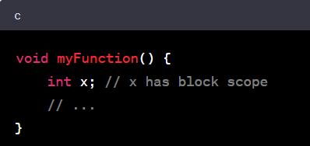
Scope of Variables
In C, the scope of a variable defines where in the program the variable can be used or accessed. The scope of a variable is determined by where it is declared, and it affects the variable's visibility and lifetime. There are primarily three types of variable scopes in C:
1. **Block Scope (Local Scope)**:
- Variables declared within a block of code, typically enclosed within curly braces `{}`, have block scope.
- Block-scope variables are also known as local variables.
- They are only accessible within the block in which they are declared, including any nested blocks.
- Local variables have automatic storage duration, which means they are created when the block is entered and destroyed when the block is exited.
- Examples of block-scope variables include function parameters and variables declared inside functions or within loops.

Slide 35
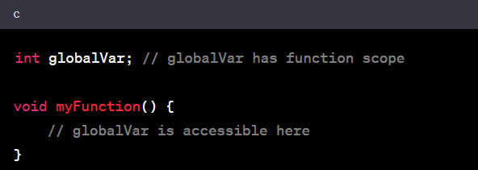
Scope of Variables
2. **Function Scope**:
- Variables declared outside of any function or block have function scope.
- Function-scope variables are also known as global variables.
- They are accessible from the point of declaration to the end of the file (translation unit) in which they are defined.
- Global variables have static storage duration, which means they exist throughout the program's execution.
- Global variables can be accessed by any function in the file without needing to pass them as arguments.

Slide 36
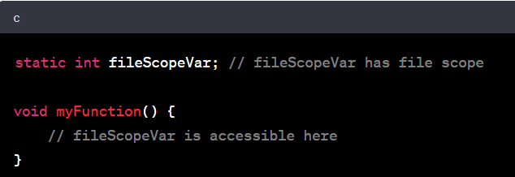
Scope of Variables
3. **File Scope (Static Scope)**:
- Variables declared as `static` at the global level have file scope.
- File-scope variables are also accessible throughout the entire file in which they are defined.
- They are not accessible from other files (unless explicitly declared as `extern` in those files).
- Like global variables, file-scope variables have static storage duration.

Slide 37
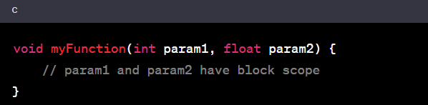
Scope of Variables
4. **Function Parameters**:
- Function parameters have block scope.
- They are local to the function in which they are declared.
- Parameters are essentially local variables that are initialized with the values passed to the function when it is called.

Slide 38
Sequencial program
A sequential program, also known as a serial program, is a type of computer program that executes a series of instructions or operations one after the other in a linear fashion.
In other words, the program flows sequentially from the beginning to the end, with each instruction being executed in order without branching or parallelism.
Sequential programs are the most common type of programs and are suitable for many tasks, especially those that do not require concurrent or parallel processing.
Here's a simple example of a sequential program in C that calculates the sum of two numbers and displays the result:

Slide 39
Sequencial program
#include <stdio.h>
int main() {
// Declare variables
int num1, num2, sum;
// Prompt the user for input
printf("Enter the first number: ");
scanf("%d", &num1);
printf("Enter the second number: ");
scanf("%d", &num2);
// Calculate the sum
sum = num1 + num2;
// Display the result
printf("The sum of %d and %d is %d\n", num1, num2, sum);
// Exit the program
return 0;
}

Slide 40
Sequencial program
In this sequential program:
1. Variables `num1`, `num2`, and `sum` are declared.
2. The program prompts the user to enter two numbers, which are stored in `num1` and `num2`.
3. The sum of `num1` and `num2` is calculated and stored in the `sum` variable.
4. Finally, the program displays the result and exits.

